Slide 1
J K K NATTRAJA COLLEGE OF ENGINEERING AND TECHNOLOGY
TEAM MEMBERS:
T.AARTHI
C.CHITRADEVI
R. DIVYA
E.DURGA
MENTOR:
MURUGASHANKAR S

Slide 2
CUSTOMER SEGMENT USING DATA SCIENCE.
ABSTRACTION
Customer segmentation is the process of dividing customers into groups based on their behavior, demographics, and other characteristics. Data science techniques can be used to analyze customer data and identify patterns and trends that can help businesses make more informed decisions about how to market and sell their products or services.

Slide 3
Problem Statement:
Customer segmentation is a critical task for businesses to effectively target their marketing efforts, personalize customer experiences, and optimize business strategies. However, traditional segmentation approaches often rely on limited variables and fail to capture the complex patterns and nuances in customer behavior. There is a need for an innovative data science solution that can provide more accurate and actionable customer segments

Slide 4
Data Collection and Preprocessing:
Gather relevant customer data from various sources, such as transaction history, demographics, online behavior, and customer feedback.
Clean and preprocess the data, ensuring accuracy and consistency.
Explore additional external data sources, such as social media data or third-party datasets, to enhance the segmentation model's accuracy.

Slide 5
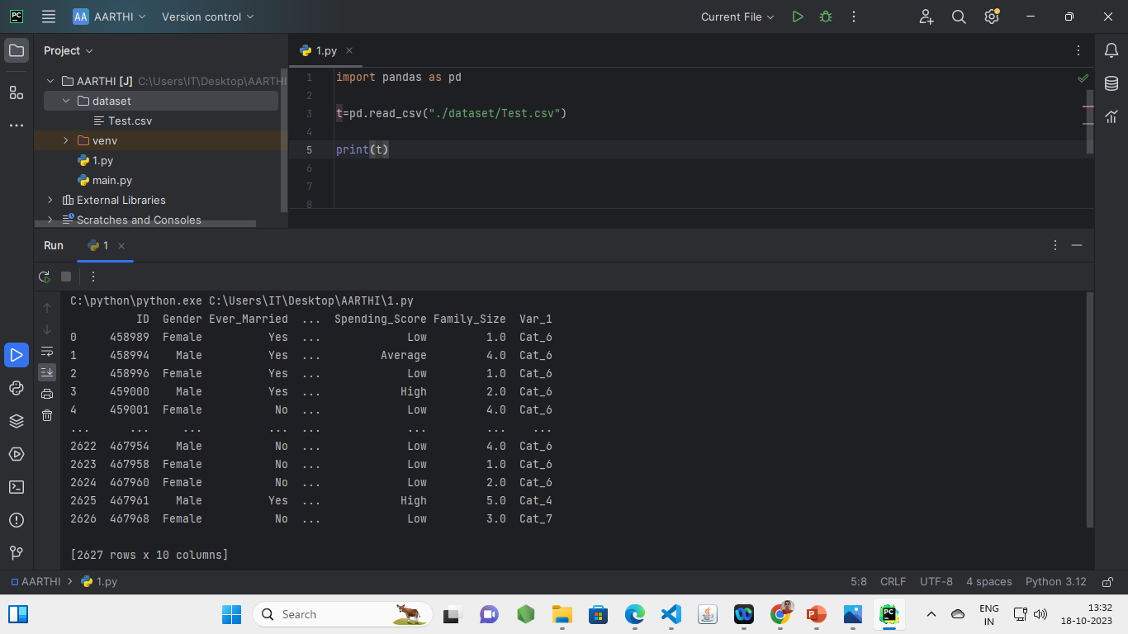
Programming code before preprocessing:

Slide 6
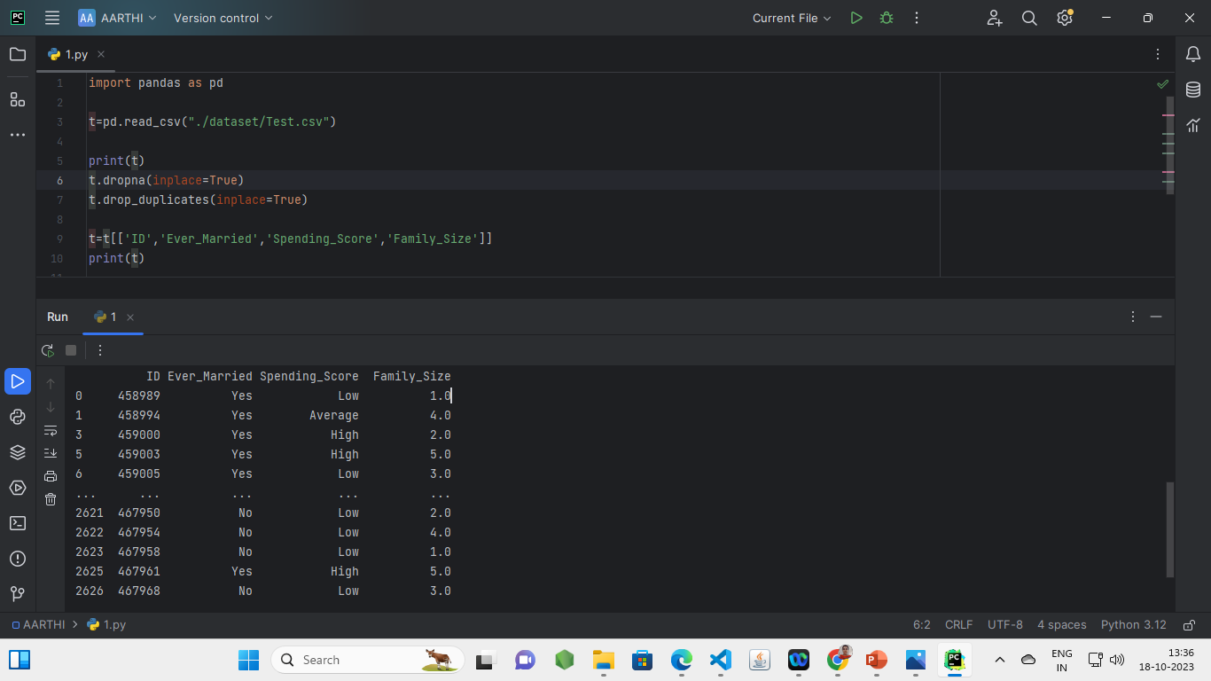
Programming code after preprocessing:

Slide 7
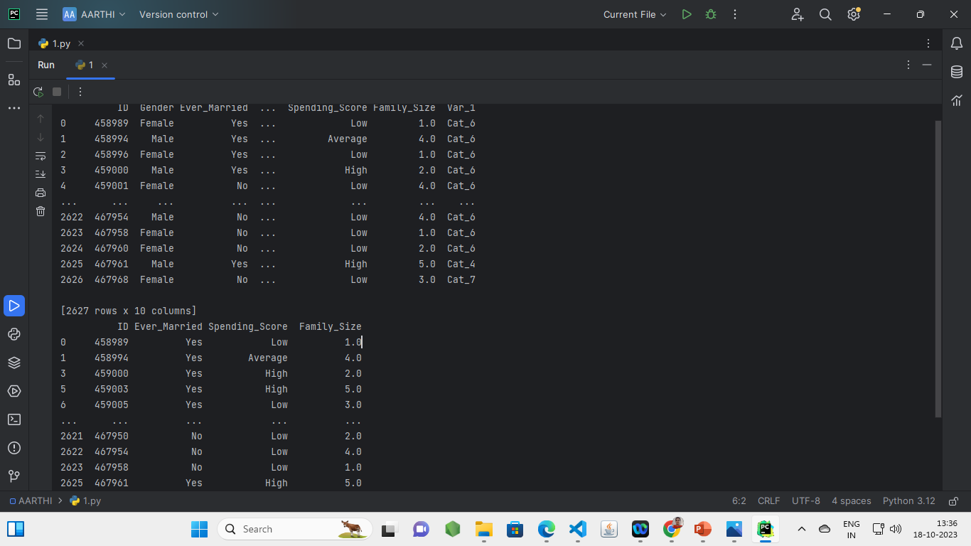
output:

Slide 8
Source:
Customer Segmentation using Data Science with the use of Kaggle.
Used software for programming:
Pycharm with installed Pandas.

Slide 9
Thank you…!!!

